Slide 1
TeamUp
Team: Awesome
Team members: Yu Liu 219391L
Hao Zhou2217801Z
Chigozie Ekwonu 2228371E
Ye Zhang 2169165

Slide 2
Overview
The problem and the application
Two user personas
Wireframes
Functionality
High level architecture and the ER diagram

Slide 3
Problem
Some students are faced with difficulties finding team members when it is required for them to execute projects in a team.
Some teams may have incomplete members
Some teams end up having a member that may not contribute much towards the success of the project due to lack of required skills

Slide 4
The Application
Aims to link teams requiring member(s) and students requiring teams together.
A student can make a request for members to complete his or her team
A student can respond to an existing request for team members, indicating interest in joining the team

Slide 5
User Personas

Slide 6

Kate Warner
Kate is a 24 year old student undergoing an MSc programme in Information Technology at Glasgow university. She has a degree in Psychology but has learnt a bit of HTML and CSS for static websites design.
She is required in most of her courses to undertake projects as a team. The lecturers’ leave the students with the option to form teams themselves. She is a bit of an introvert, and finds it difficult to make friends. As a result, she finds it difficult to form teams of her own and mostly ends up informing her lecturers of her inability to find a team.
She is currently undertaking a course in Internet Technology and is mandated to undertake a team project to develop a Django based web application. She is a bit skilled in UI design and can contribute positively to the development of the application. She hopes to use TeamUp to find a team to join for the project.

Slide 7

Tom Ford
Tom Ford, Fred Bommer, Rose Williamson and Lizzy Evans are very good friends, and are all 4th year students, studying Computer Science at the University of Glasgow.
Lizzy recently moved to the USA to join the Computer Science department of Stanford University as an exchange student. Tom, Fred, Rose and Lizzy normally undertake group projects together.
All 4th year students of computer science at Glasgow University are required to undertake a project, done in groups of four. Tom, Fred and Rose are thus short of a person to complete their group.
Tom recently learns of a new web application through which they can find a student to complete their team and he volunteers to find a student to complete the team by making use of the website.

Slide 8
Wireframes and diagrams

Slide 9
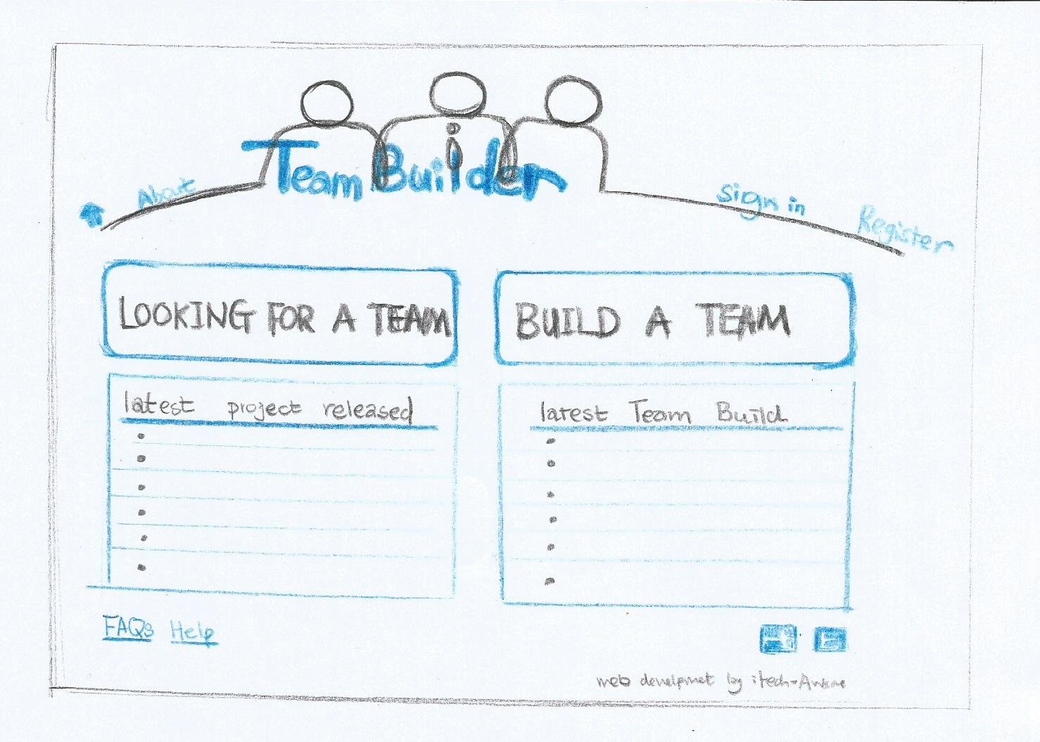
Homepage

Slide 10
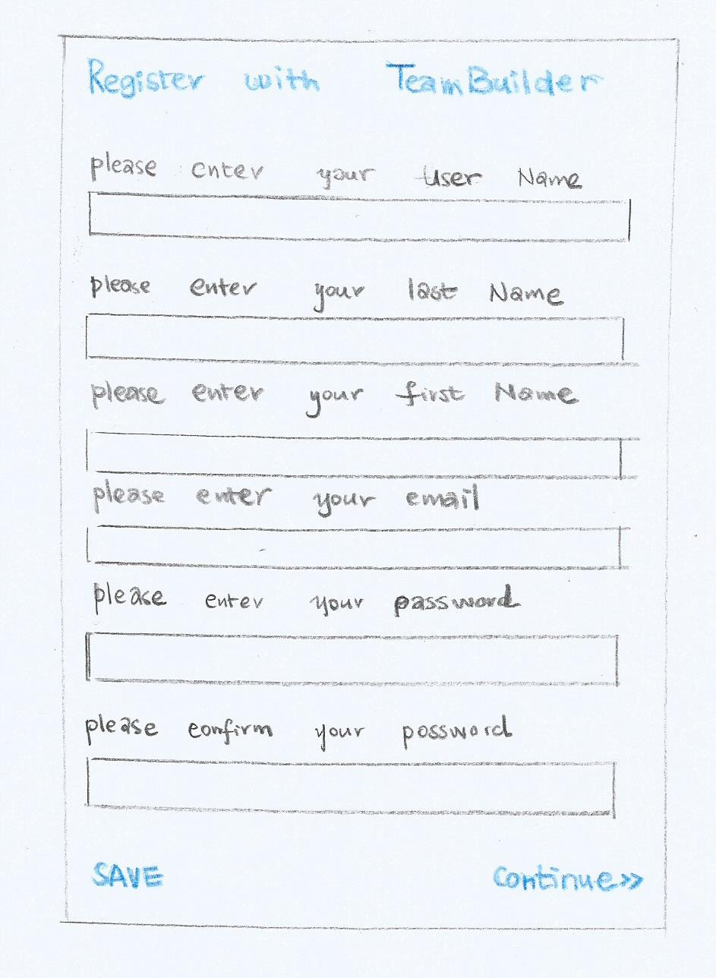
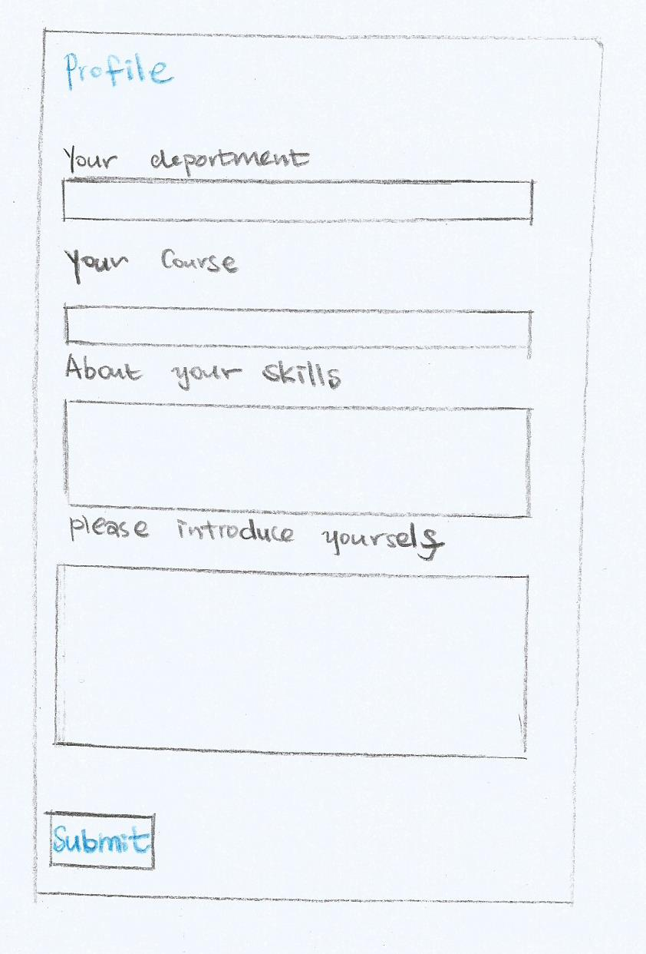
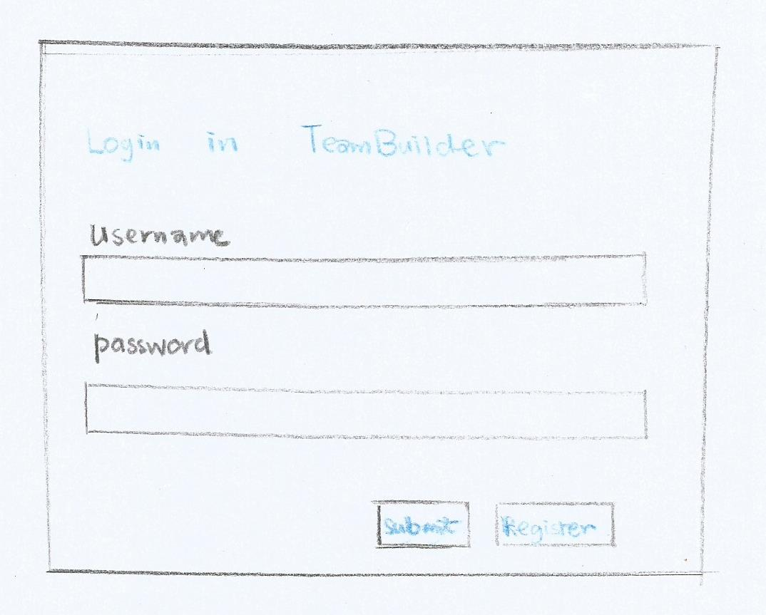
Register & Logging in

Slide 11
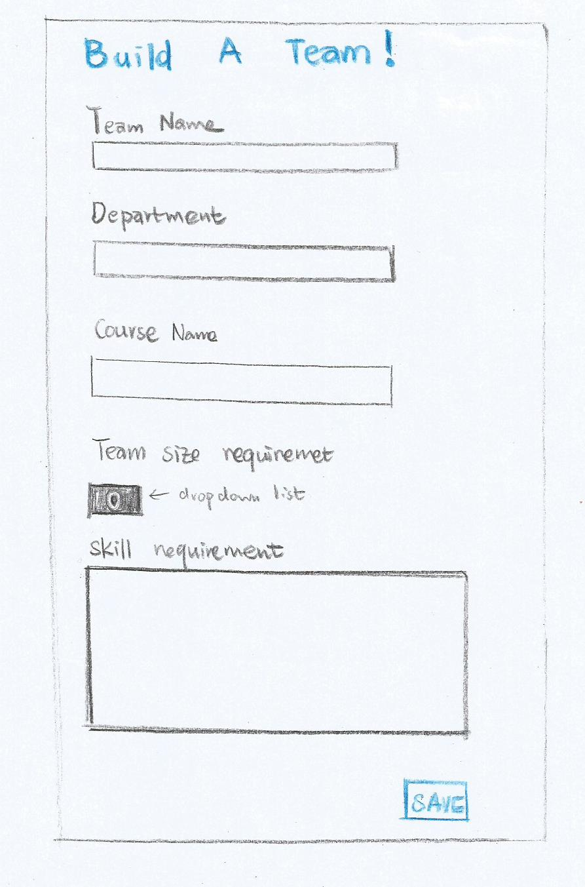
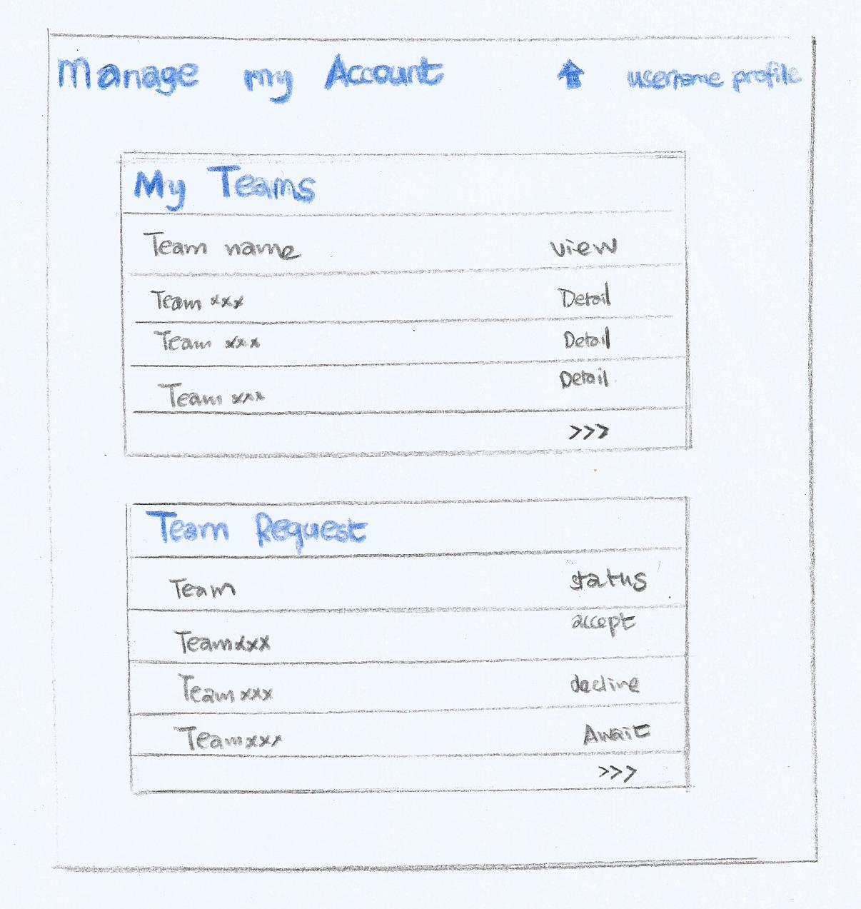
Build a Team and add a member

Slide 12
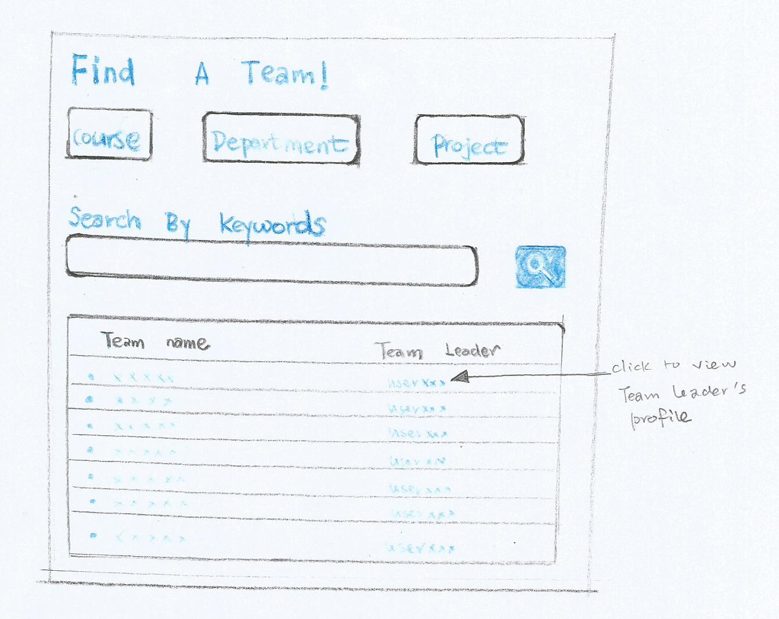
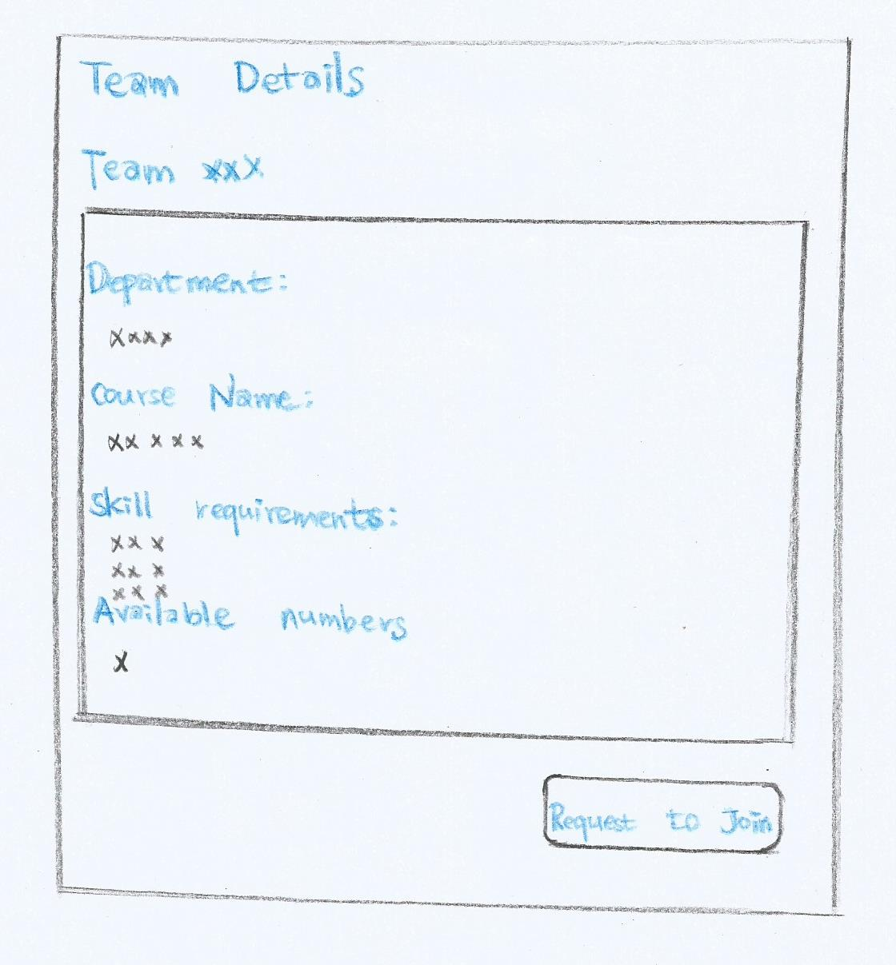
Looking for a team and team request

Slide 13
Functionality Summary
Allow users to register and verify themselves for logging in
Allow user to update personal profile
Allow user to create request for team member
System will automatically suggest students for a team by matching the required skills for the project with the skills listed in student’s profile
Allow user to look for a team to join
Allow user to send request to join a team
Allow user accept a student’s request to join a team

Slide 14
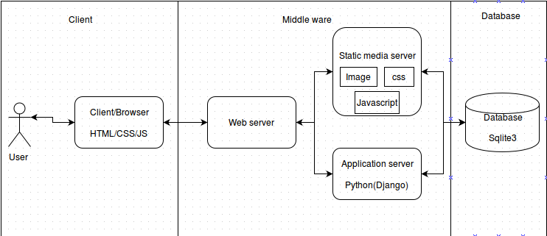
High level architecture

Slide 15
ER Diagram

Slide 16
ER Diagram (cont)
Entity attributes and their types
Student
Field | Type
student_id | Integer
fname | Char(128)
sname | Char(128)
email | Char(128)
phone_number | Char(15)
username | Char(50)
password | Char(150)
dob | Datetime
department | Char(10)
about_me | Text
MemberRequest
Field | Type
student | Integer
name | Text
description | Text
course | char(15)
size | Integer
status | boolean
creation_date | Datetime
required_skills | Text
Department
Field | Type
code | char(15)
name | char(100)
MemberRequestResponse
Field | Type
member_request | Integer
responder | Integer
Course
Field | Type
code | char(15)
name | char(100)
department | char(15)
Skill
Field | Type
student | Integer
skill_name | char(20)

